Slide 1
Year 2, Unit 2
Calculations within 20
Notes:
ANIMATION PROBLEM

Slide 2
Year 2, Unit 2
These materials heavily reflect the prioritisation approach of the ready-to-progress criteria in the DfE Primary Mathematics Guidance 2020 and on the PPTs that exemplify them on the NCETM website. They also include other relevant National Curriculum content. Related sections of the NCETM Primary Mastery Professional Development Materials provide small-step teaching guidance.
Ready-to-progress criteria addressed by this unit
Teaching of this unit supports the following criteria from the ‘DfE Mathematics Guidance: key stages 1 & 2’ (the 335-page document available as a download)
2AS-1 Page 57
2AS-2 Page 59
Prior learning
There are no specific ready-to-progress criteria supporting the prior learning for this unit. The year 1 conceptual prerequisites are:
Learn and use number bonds to 10, for example: 8 + ? = 10
Partition numbers within 10, for example: 5 = 2 + 3
Solve missing addend problems within 10, for example: 4 + □ = 10

Slide 3
Contents
The links below take you to the starting slide of each learning outcome.
1 | Pupils add three addends
2 | Pupils use a ‘First... Then… Now” story to add 3 addends
3 | Pupils explain that addends can be added in any order
4 | Pupils add 3 addends efficiently
5 | Pupils add 3 addends efficiently by finding two addends that total 10
6 | Pupils add two numbers that bridge through 10
7 | Pupils subtract two numbers that bridge through 10
Click the arrow button to return to this Contents slide.

Slide 4
Contents
The links below take you to the starting slide of each learning outcome.
8 | Pupils compare numbers and describe how many more or less there are in each set
9 | Pupils calculate the difference
10 | Pupils use knowledge of subtraction to solve problems in a range of contexts
11 | Pupils explain what the difference is between consecutive numbers
12 | Pupils calculate difference when information is presented in a pictogram
13 | Pupils calculate difference when information is presented in a bar chart
Click the arrow button to return to this Contents slide.

Slide 5
Year 2, Unit 2, Learning Outcome 1
Learning Outcome 1
Pupils add three addends
The following slides have been collated to support the teaching of this learning outcome.

Slide 6
Year 2, Unit 2, Learning Outcome 1
Additional teacher guidance for this outcome should be read first and can be found in this segment of the NCETM Primary Mastery Professional Development Materials:
1.11 Addition and subtraction: bridging 10
The spine materials are divided into ‘teaching points’ and ‘steps in learning’.
Teaching point | Steps in learning | Pages
1 | 1:1 - 1:3 | 3-4

Slide 7
1.11 Addition: three numbers and bridging 10 – step 1:1
2 + 3 + 5
= 10

Slide 8
1.11 Addition: three numbers and bridging 10 – step 1:1
6 + 0 + 3
= 9
Notes:
The children play a game. Now Madison has six marbles, Charlie has no marbles and Asif has three marbles. They have nine marbles altogether.

Slide 9
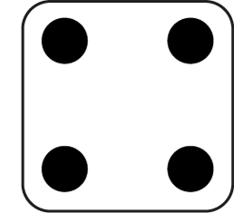
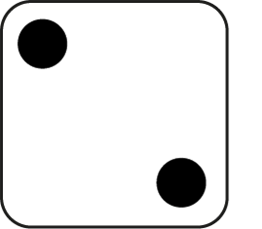
1.11 Addition: three numbers and bridging 10 – step 1:1
2
+
3
+
4
= 9

Slide 10
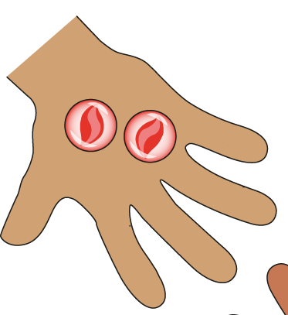
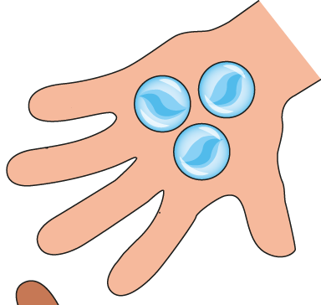
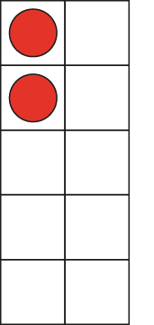
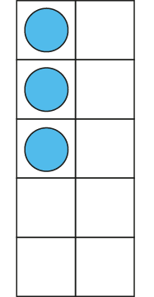
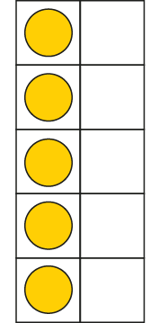
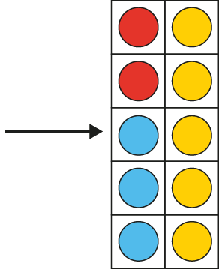
1.11 Addition: three numbers and bridging 10 – step 1:2
2 + 3 + 5
= 10

Slide 11
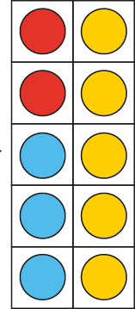
1.11 Addition: three numbers and bridging 10 – step 1:2
10 = 2 + 3 + 5
Notes:
Madison has two red marbles, Charlie has three blue marbles and Asif has five yellow marbles. They have ten marbles altogether.

Slide 12
1.11 Addition: three numbers and bridging 10 – step 1:3
2 + 3 + 5
= 10
Notes:
Madison has two red marbles, Charlie has three blue marbles and Asif has five yellow marbles. They have ten marbles altogether.

Slide 13
Year 2, Unit 2, Learning Outcome 2
Learning Outcome 2
Pupils use a ‘First... Then… Now” story to add 3 addends
The following slides have been collated to support the teaching of this learning outcome.

Slide 14
Year 2, Unit 2, Learning Outcome 2
Additional teacher guidance for this outcome should be read first and can be found in this segment of the NCETM Primary Mastery Professional Development Materials:
1.11 Addition and subtraction: bridging 10
The spine materials are divided into ‘teaching points’ and ‘steps in learning’.
Teaching point | Steps in learning | Pages
2 | 2:1 - 2:5 | 5-6

Slide 15
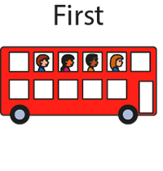
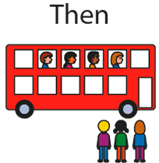
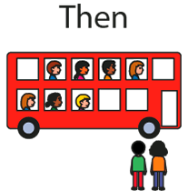
1.11 Addition: three numbers and bridging 10 – step 2:1

Slide 16
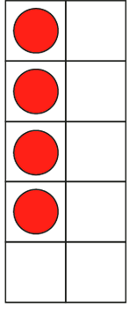
1.11 Addition: three numbers and bridging 10 – step 2:2
First, four children were sitting on a bus.
Then, three more children got on the bus…
… and then two more children got on.
Now, nine children are sitting on the bus.

Slide 17
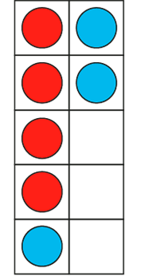
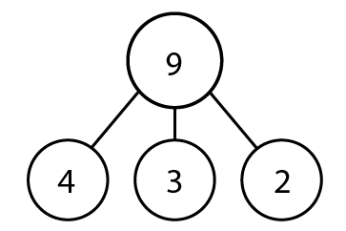
1.11 Addition: three numbers and bridging 10 – step 2:2
9 = 4 + 3 + 2

Slide 18
1.11 Addition: three numbers and bridging 10 – step 2:3
4 + 3 + 2 = 9

Slide 19
1.11 Addition: three numbers and bridging 10 – step 2:4
Notes:
A snail is two centimetres up a flower stalk. Then it crawls up four centimetres, and then one centimetre more. How high up the stalk is it now?’

Slide 20
1.11 Addition: three numbers and bridging 10 – step 2:5
Which equation matches this number line?
3 + 3 = 6
0 + 3 + 3 = 6
3 + 3 + 6 = 12

Slide 21
Year 2, Unit 2, Learning Outcome 3
Learning Outcome 3
Pupils explain that addends can be added in any order
The following slides have been collated to support the teaching of this learning outcome.

Slide 22
Year 2, Unit 2, Learning Outcome 3
Additional teacher guidance for this outcome should be read first and can be found in this segment of the NCETM Primary Mastery Professional Development Materials:
1.11 Addition and subtraction: bridging 10
The spine materials are divided into ‘teaching points’ and ‘steps in learning’.
Teaching point | Steps in learning | Pages
3 | 3:1 - 3:3 | 7-9

Slide 23
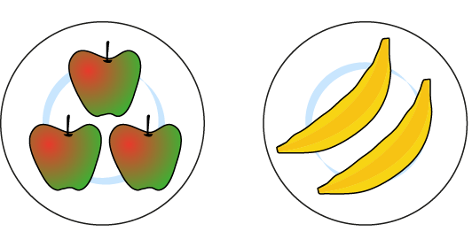
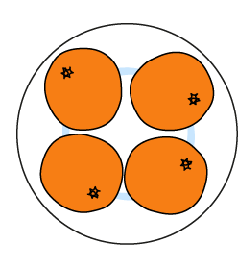
1.11 Addition: three numbers and bridging 10 – step 3:1
3 + 2
+ 4
5
+ 4
3 + 2
+ 4 =
+ 4
= 9
5

Slide 24
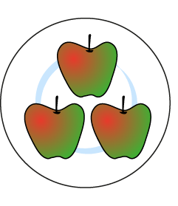
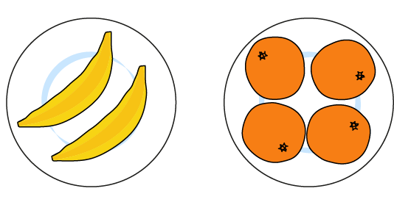
1.11 Addition: three numbers and bridging 10 – step 3:1
3 +
2 + 4
3 +
6
= 9
6
3 +
2 + 4
=
3 +

Slide 25
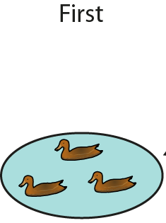
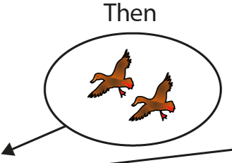
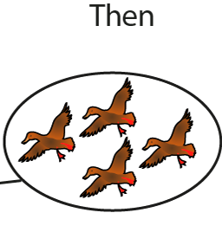
1.11 Addition: three numbers and bridging 10 – step 3:2

Slide 26
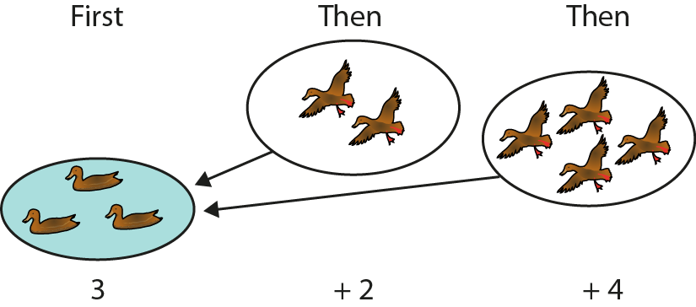
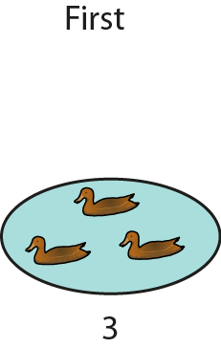
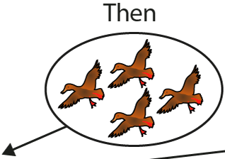
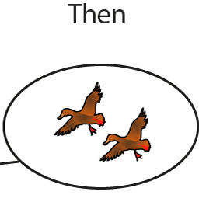
1.11 Addition: three numbers and bridging 10 – step 3:2
3 + 2 + 4 = 3 + 4 + 2

Slide 27
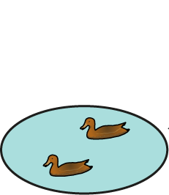
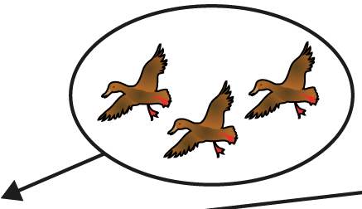
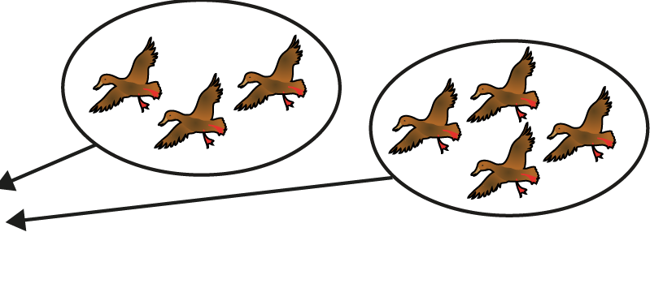
1.11 Addition: three numbers and bridging 10 – step 3:2
3 + 2 + 4 = 2 + 3 + 4

Slide 28
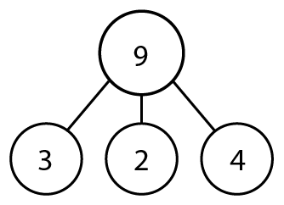
1.11 Addition: three numbers and bridging 10 – step 3:3

Slide 29
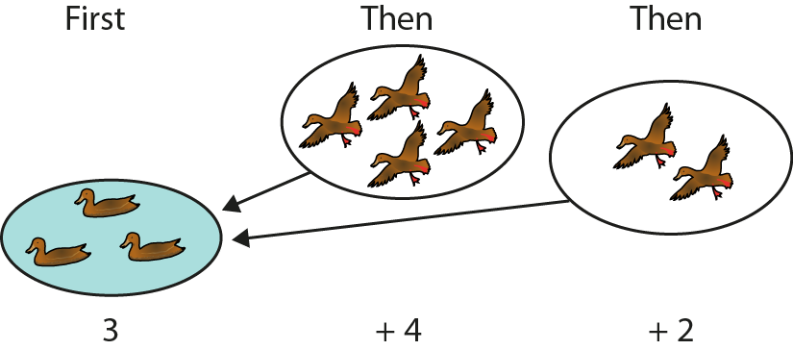
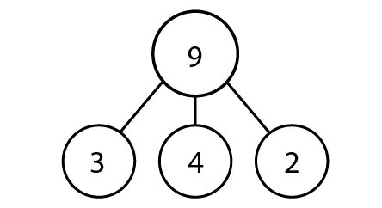
1.11 Addition: three numbers and bridging 10 – step 3:3

Slide 30
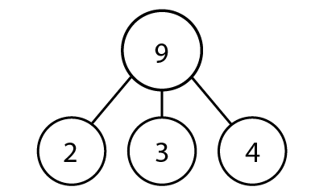
1.11 Addition: three numbers and bridging 10 – step 3:3
2

Slide 31
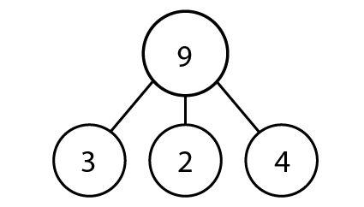
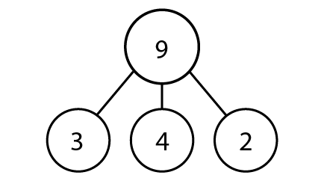
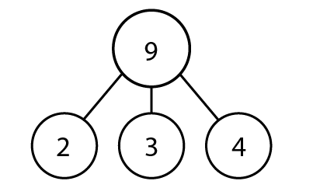
1.11 Addition: three numbers and bridging 10 – step 3:3

Slide 32
Year 2, Unit 2, Learning Outcome 4
Learning Outcome 4
Pupils add 3 addends efficiently
The following slides have been collated to support the teaching of this learning outcome.

Slide 33
Year 2, Unit 2, Learning Outcome 4
Additional teacher guidance for this outcome should be read first and can be found in this segment of the NCETM Primary Mastery Professional Development Materials:
1.11 Addition and subtraction: bridging 10
The spine materials are divided into ‘teaching points’ and ‘steps in learning’.
Teaching point | Steps in learning | Pages
4 | 4:1 - 4:4 | 10-11

Slide 34
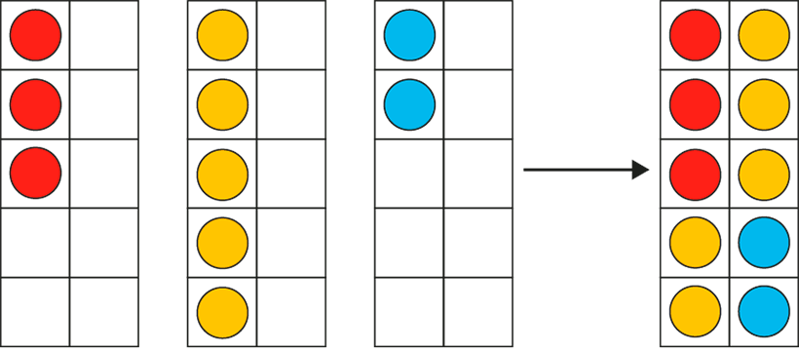
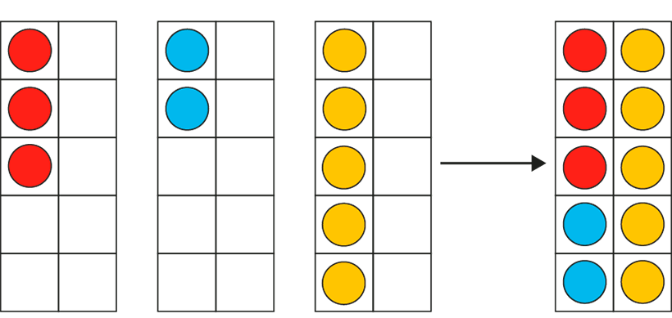
1.11 Addition: three numbers and bridging 10 – step 4:1
Notes:
In my toy box, I have three red cars, five yellow cars and two blue cars. I have ten cars altogether.’

Slide 35
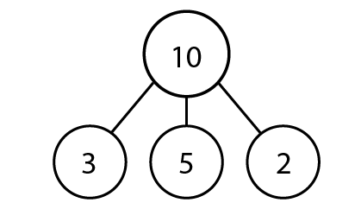
1.11 Addition: three numbers and bridging 10 – step 4:2

Slide 36
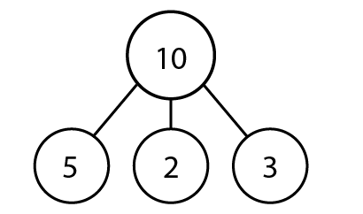
1.11 Addition: three numbers and bridging 10 – step 4:2

Slide 37
1.11 Addition: three numbers and bridging 10 – step 4:3
6
9
2 + 4 + 3 = + 3 =

Slide 38
1.11 Addition: three numbers and bridging 10 – step 4:3
5
9
2 + 4 + 3 = + 4 =

Slide 39
1.11 Addition: three numbers and bridging 10 – step 4:3
7
9
2 + 4 + 3 = + 2 =

Slide 40
1.11 Addition: three numbers and bridging 10 – step 4:3
3
4
7
2 + 1 + 4 = + =

Slide 41
1.11 Addition: three numbers and bridging 10 – step 4:3
2
5
7
2 + 1 + 4 = + =

Slide 42
1.11 Addition: three numbers and bridging 10 – step 4:3
6
1
7
2 + 1 + 4 = + =

Slide 43
1.11 Addition: three numbers and bridging 10 – step 4:4
Fill in the missing squares, using the numbers 0, 1, 2, 4, 5 and 6, so that each row and column adds up to the same number.
4
5
0
3
3
3
2
1
6

Slide 44
Year 2, Unit 2, Learning Outcome 5
Learning Outcome 5
Pupils add 3 addends efficiently by finding two addends that total 10
The following slides have been collated to support the teaching of this learning outcome.

Slide 45
Year 2, Unit 2, Learning Outcome 5
Additional teacher guidance for this outcome should be read first and can be found in this segment of the NCETM Primary Mastery Professional Development Materials:
1.11 Addition and subtraction: bridging 10
The spine materials are divided into ‘teaching points’ and ‘steps in learning’.
Teaching point | Steps in learning | Pages
4 | 4:5 - 4:10 | 12-14

Slide 46
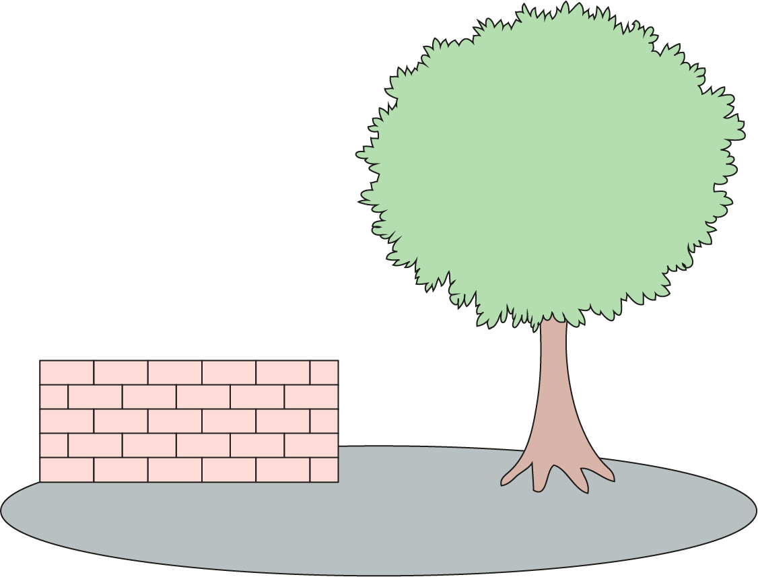
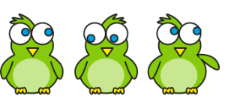
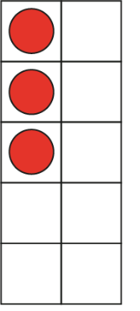
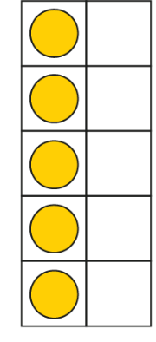
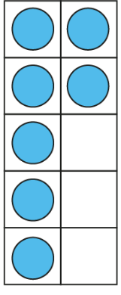
1.11 Addition: three numbers and bridging 10 – step 4:5
5
+ 10
3
+ 5
+ 7
= 5 + 10
3
+ 5
+ 7

Slide 47
1.11 Addition: three numbers and bridging 10 – step 4:6
5 + 6 + 5 =
16

Slide 48
1.11 Addition: three numbers and bridging 10 – step 4:6
3 + 3 + 7 =
13

Slide 49
1.11 Addition: three numbers and bridging 10 – step 4:6
7 + 4 + 3 =
14

Slide 50
1.11 Addition: three numbers and bridging 10 – step 4:6
8 + 4 + 2 =
14

Slide 51
1.11 Addition: three numbers and bridging 10 – step 4:6
2 + 8 + 6 =
16

Slide 52
1.11 Addition: three numbers and bridging 10 – step 4:7
7 + 5 + 5
4 + 8 + 5
7 + 6 + 2
1 + 3 + 9
Can make 10 | Cannot make 10

Slide 53
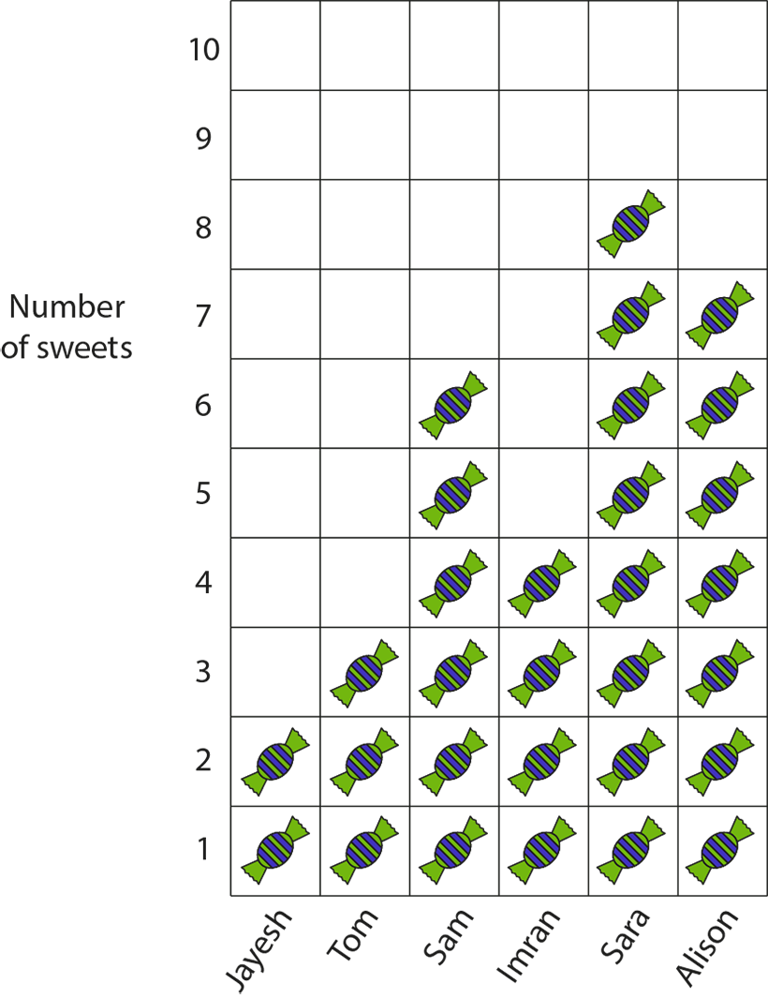
1.11 Addition: three numbers and bridging 10 – step 4:9
Notes:
Ask questions such as ‘How many sweets do Jayesh, Sam and Sara have together?’ (2 + 6 + 8).

Slide 54
Year 2, Unit 2, Learning Outcome 6
Learning Outcome 6
Pupils add two numbers that bridge through 10
The following slides have been collated to support the teaching of this learning outcome.

Slide 55
Year 2, Unit 2, Learning Outcome 6
Additional teacher guidance for this outcome should be read first and can be found in this segment of the NCETM Primary Mastery Professional Development Materials:
1.11 Addition and subtraction: bridging 10
The spine materials are divided into ‘teaching points’ and ‘steps in learning’.
Teaching point | Steps in learning | Pages
5 | 5:1 - 5:7 | 15-18

Slide 56
1.11 Addition: three numbers and bridging 10 – step 5:1
7 + 5
= 7 + 3 + 2
= 10 + 2
Notes:
A ride at the funfair has ten seats in each carriage. You have to fill up the whole carriage before children can get in a new one. There are seven children in the first carriage. Five more get on. How many children are there altogether?’
‘Three children can get in the first carriage and two children get in the next carriage.

Slide 57
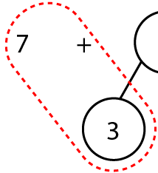
1.11 Addition: three numbers and bridging 10 – step 5:2
7
+
5
3
2
7 + 3
= 10
10 + 2
= 12

Slide 58
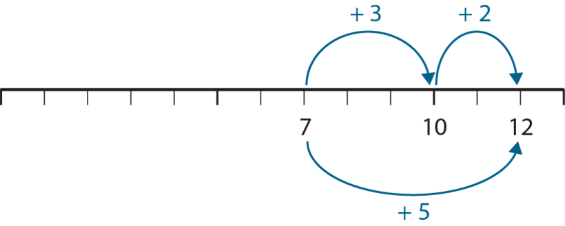
1.11 Addition: three numbers and bridging 10 – step 5:4

Slide 59
2AS-1 Add and subtract across 10
Try these calculations using two ten frames and different coloured counters.
For each calculation, talk about how we can make ten and how we will have to partition the second number.
As children become more confident, they can record each part of the calculation as they move the counters, and talk about how it represents what is on the ten frames.
Check that children are using known bonds of ten to partition numbers, and place value knowledge to add a single digit to ten, rather than counting.
7 + 6
7 + 8
7 + 5
8 + 5
9 + 5

Slide 60
Year 2, Unit 2, Learning Outcome 7
Learning Outcome 7
Pupils subtract two numbers that bridge through 10
The following slides have been collated to support the teaching of this learning outcome.

Slide 61
Year 2, Unit 2, Learning Outcome 7
Additional teacher guidance for this outcome should be read first and can be found in this segment of the NCETM Primary Mastery Professional Development Materials:
1.11 Addition and subtraction: bridging 10
The spine materials are divided into ‘teaching points’ and ‘steps in learning’.
Teaching point | Steps in learning | Pages
6 | 6:1 - 6:8 | 19-25

Slide 62
1.11 Addition: three numbers and bridging 10 – step 6:1

Slide 63
1.11 Addition: three numbers and bridging 10 – step 6:1
− 4
− 2
− 2
8
10
12

Slide 64
1.11 Addition: three numbers and bridging 10 – step 6:1

Slide 65
1.11 Addition: three numbers and bridging 10 – step 6:1
2
2
12 −
2
= 10
10 −
2
= 8
12 −
4
= 8

Slide 66
1.11 Addition: three numbers and bridging 10 – step 6:2

Slide 67
1.11 Addition: three numbers and bridging 10 – step 6:2
4
10
2
10
−
4
=
6
6
+
2
= 8
12 −
4
= 8

Slide 68
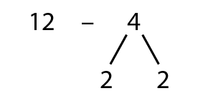
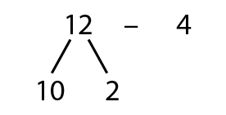
1.11 Addition: three numbers and bridging 10 – step 6:3
12 − 4 = 8
12 −
10
−
4
= 6
2
= 10
6
2
= 8
10 −
+
2
= 8
12 −
4
= 8
12 −
4
= 8

Slide 69
1.11 Addition: three numbers and bridging 10 – step 6:4
15 − 9
5
4
15
− 5
= 10
10
− 4
= 6
15
− 9
= 6

Slide 70
1.11 Addition: three numbers and bridging 10 – step 6:4
− 9
− 4
− 5
6
10
15

Slide 71
1.11 Addition: three numbers and bridging 10 – step 6:4

Slide 72
1.11 Addition: three numbers and bridging 10 – step 6:4
15 − 9
10
5
15
= 1
10
− 9
1
+ 5
= 6
15
− 9
= 6

Slide 73
1.11 Addition: three numbers and bridging 10 – step 6:4
15 − 9 = 6
5
= 10
15 −
10
−
9
= 1
4
= 6
5
= 6
10 −
1
+
9
= 6
9
= 6
15 −
15 −

Slide 74
1.11 Addition: three numbers and bridging 10 – step 6:5
12 − 3
= 9
2
= 10
12 −
10 −
1
= 9

Slide 75
1.11 Addition: three numbers and bridging 10 – step 6:5
= 6
14 − 8
8
= 2
10 −
2 +
4
= 6

Slide 76
1.11 Addition: three numbers and bridging 10 – step 6:5

Slide 77
1.11 Addition: three numbers and bridging 10 – step 6:5

Slide 78
1.11 Addition: three numbers and bridging 10 – step 6:5

Slide 79
2AS-1 Add and subtract across 10
Method 1
Subtracting through 10
Method 2
Subtracting from 10
Let’s compare the methods.
Which number was partitioned in each method - the minuend or the subtrahend?
Can you explain how partitioning 9 into 5 and 4 helped us?
Can you explain how partitioning 15 into 10 and 5 helped us?
Which strategy do you prefer?
15 – 9

Slide 80
2AS-1 Add and subtract across 10
Now repeat the 2 methods for 15 – 9.
Use the words in the boxes as you move the counters.
Work with a partner and aske them to write the equations as you move the counters :
Method 1 Method 2
Now practise with other numbers using your tens frames and the words in the boxes and write the equations.
14 – 6 12 – 5
13 – 7 17 – 9
Can you do these calculations without using
the tens frames?
Method 1
The nine is partitioned into 5 and 4.
Take away 5 is 10.
Take away 4 from 10 is 6.
The answer is 6.
15
− 5
= 10
10 – 9 = 1
10
− 4
= 6
1 + 5 = 6
15
− 9
= 6
15
− 9
= 6
Method 2
The 15 is partitioned into 10 and 5.
Take away 9 from the 10, this leaves 1.
Put 1 and 5 together.
The answer is 6

Slide 81
Year 2, Unit 2, Learning Outcome 8
Learning Outcome 8
Pupils compare numbers and describe how many more or less there are in each set
The following slides have been collated to support the teaching of this learning outcome.

Slide 82
Year 2, Unit 2, Learning Outcome 8
Additional teacher guidance for this outcome should be read first and can be found in this segment of the NCETM Primary Mastery Professional Development Materials:
1.12 Addition and subtraction: subtraction as difference
The spine materials are divided into ‘teaching points’ and ‘steps in learning’.
Teaching point | Steps in learning | Pages
1 | 1:1 - 1:4 | 3-6

Slide 83
1.12 Subtraction as difference – step 1:1

Slide 84
1.12 Subtraction as difference – step 1:1

Slide 85
1.12 Subtraction as difference – step 1:2
2 cars

Slide 86
1.12 Subtraction as difference – step 1:2
2 cars
2 cars

Slide 87
1.12 Subtraction as difference – step 1:2
5 red cars
3 blue cars
2 cars

Slide 88
1.12 Subtraction as difference – step 1:3
difference of 3

Slide 89
1.12 Subtraction as difference – step 1:3
difference of 4

Slide 90
1.12 Subtraction as difference – step 1:3
Ben is ten years old
Charlotte is three years old
10 years old
3 years old
difference of 7 years

Slide 91
1.12 Subtraction as difference – step 1:4
7
4
3

Slide 92
1.12 Subtraction as difference – step 1:4
3

Slide 93
Year 2, Unit 2, Learning Outcome 9
Learning Outcome 9
Pupils calculate the difference
The following slides have been collated to support the teaching of this learning outcome.

Slide 94
Year 2, Unit 2, Learning Outcome 9
Additional teacher guidance for this outcome should be read first and can be found in this segment of the NCETM Primary Mastery Professional Development Materials:
1.12 Addition and subtraction: subtraction as difference
The spine materials are divided into ‘teaching points’ and ‘steps in learning’.
Teaching point | Steps in learning | Pages
2 | 2:1 - 2:4 | 7-9

Slide 95
1.12 Subtraction as difference – step 2:1
Notes:
There are eight children and only three pencils. How many more pencils does the teacher need so each child has one pencil?

Slide 96
1.12 Subtraction as difference – step 2:1
8
3
5
8 – 3 = 5

Slide 97
1.12 Subtraction as difference – step 2:1
8
3
5
5
8 – 3 = 5

Slide 98
1.12 Subtraction as difference – step 2:2

Slide 99
1.12 Subtraction as difference – step 2:3
3 =
4 – 1
5 – 2
6 – 3
7 – 4

Slide 100
2AS-2 Solve comparative addition and difference problems
10 + = 16 16 – 10 = ___
Look at the bar model. What pair of numbers is it showing the difference between? What is the difference between these numbers? How do you know?
How does the number line show this difference?
What calculations could we write to represent the difference between this pair of numbers?
What is the same and what is different about the calculations?
16
10
6
6
0
1
2
3
4
5
6
7
8
9
10
11
12
13
14
15
16

Slide 101
2AS-2 Solve comparative addition and difference problems
Sketch a bar model and find the difference between these pairs of numbers using subtraction.
7 and 4
6 and 9
5 and 8
17 and 14
16 and 19
15 and 18
£42 and £40
£25 and £35
£40 and £10
9p and 15p
15p and 9p
26p and 29p

Slide 102
Year 2, Unit 2, Learning Outcome 10
Learning Outcome 10
Pupils use knowledge of subtraction to solve problems in a range of contexts
The following slides have been collated to support the teaching of this learning outcome.

Slide 103
Year 2, Unit 2, Learning Outcome 10
Additional teacher guidance for this outcome should be read first and can be found in this segment of the NCETM Primary Mastery Professional Development Materials:
1.12 Addition and subtraction: subtraction as difference
The spine materials are divided into ‘teaching points’ and ‘steps in learning’.
Teaching point | Steps in learning | Pages
2 | 2:5 | 9-10

Slide 104
1.12 Subtraction as difference – step 2:5
5 – 3 = 2
Notes:
Five children are playing in the playground. Three are playing on the swings; the rest are playing on the roundabout. How many are playing on the roundabout?
(partitioning)

Slide 105
1.12 Subtraction as difference – step 2:5
5 – 3 = 2
Notes:
At first there were five swans on a lake, then three flew away. How many swans are on the lake now?
(reduction)

Slide 106
1.12 Subtraction as difference – step 2:5
2
5 – 3 = 2
Notes:
There are five ducks on the pond and three ducks on the lake. How many more ducks are on the pond?
(difference)

Slide 107
2AS-2 Solve comparative addition and difference problems
I have £20 to spend at the shop.
How much more money do I need to be able to buy the Birdy Hop Game?
What about the Construction Set?
Think of your own questions using the words ‘how much more money do I need to buy the …?’ Solve your questions using subtraction.
What if I only had £10? What questions could you ask?

Slide 108
Year 2, Unit 2, Learning Outcome 11
Learning Outcome 11
Pupils explain what the difference is between consecutive numbers
The following slides have been collated to support the teaching of this learning outcome.

Slide 109
Year 2, Unit 2, Learning Outcome 11
Additional teacher guidance for this outcome should be read first and can be found in this segment of the NCETM Primary Mastery Professional Development Materials:
1.12 Addition and subtraction: subtraction as difference
The spine materials are divided into ‘teaching points’ and ‘steps in learning’.
Teaching point | Steps in learning | Pages
3 | 3:1 - 3:5 | 11-14

Slide 110
1.12 Subtraction as difference – step 3:1

Slide 111
1.12 Subtraction as difference – step 3:1
 | 0 | 1 | 2 | 3 | 4 | 5 | 6 | 7 | 8 | 9 | 10
1 | 1 − 0 | 1 − 1
2 | 2 − 0 | 2 − 1 | 2 – 2
3 | 3 − 0 | 3 − 1 | 3 – 2 | 3 – 3
4 | 4 − 0 | 4 − 1 | 4 − 2 | 4 − 3 | 4 − 4
5 | 5 − 0 | 5 − 1 | 5 − 2 | 5 − 3 | 5 − 4 | 5 − 5
6 | 6 − 0 | 6 − 1 | 6 − 2 | 6 − 3 | 6 − 4 | 6 − 5 | 6 − 6
7 | 7 − 0 | 7 − 1 | 7 − 2 | 7 − 3 | 7 − 4 | 7 − 5 | 7 − 6 | 7 − 7
8 | 8 − 0 | 8 − 1 | 8 − 2 | 8 − 3 | 8 − 4 | 8 − 5 | 8 − 6 | 8 − 7 | 8 − 8
9 | 9 − 0 | 9 − 1 | 9 − 2 | 9 − 3 | 9 − 4 | 9 − 5 | 9 − 6 | 9 − 7 | 9 − 8 | 9 − 9
10 | 10 − 0 | 10 − 1 | 10 − 2 | 10 − 3 | 10 − 4 | 10 − 5 | 10 − 6 | 10 − 7 | 10 − 8 | 10 − 9 | 10 − 10

Slide 112
1.12 Subtraction as difference – step 3:3

Slide 113
1.12 Subtraction as difference – step 3:3

Slide 114
1.12 Subtraction as difference – step 3:4

Slide 115
1.12 Subtraction as difference – step 3:4

Slide 116
Year 2, Unit 2, Learning Outcome 12
Learning Outcome 12
Pupils calculate difference when information is presented in a pictogram
The following slides have been collated to support the teaching of this learning outcome.

Slide 117
Year 2, Unit 2, Learning Outcome 12
Additional teacher guidance for this outcome should be read first and can be found in this segment of the NCETM Primary Mastery Professional Development Materials:
1.12 Addition and subtraction: subtraction as difference
The spine materials are divided into ‘teaching points’ and ‘steps in learning’.
Teaching point | Steps in learning | Pages
4 | 4:1 - 4:2 and 4:4 | 15-16

Slide 118
1.12 Subtraction as difference – step 4:1
15
12
3
12 + 3 = 15
3
15 – 12 = 15
3

Slide 119
1.12 Subtraction as difference – step 4:2
Notes:
How many more sweets does Asif have than Sandra?
How many fewer sweets does Tom have than Essie?
What is the difference between the number of sweets that Essie has and the number that Sandra has?

Slide 120
1.12 Subtraction as difference – step 4:4
Notes:
How many more socks does Asif have than Sandra?
How many fewer socks does Tom have than Essie?
What is the difference between the number of socks that Essie has and the number that Sandra has?

Slide 121
Year 2, Unit 2, Learning Outcome 13
Learning Outcome 13
Pupils calculate difference when information is presented in a bar chart
The following slides have been collated to support the teaching of this learning outcome.

Slide 122
Year 2, Unit 2, Learning Outcome 13
Additional teacher guidance for this outcome should be read first and can be found in this segment of the NCETM Primary Mastery Professional Development Materials:
1.12 Addition and subtraction: subtraction as difference
The spine materials are divided into ‘teaching points’ and ‘steps in learning’.
Teaching point | Steps in learning | Pages
4 | 4:3 | 16

Slide 123
1.12 Subtraction as difference – step 4:3
Notes:
How much more did John score than Sara?
How much less did Harry score than Saskia?
What is the difference between Saskia’s score and Paul’s score?

Slide 124
2AS-2 Solve comparative addition and difference problems
What do you think the pictogram shows us?
Can you choose the correct words (more or fewer) to complete these sentences?
Jayesh has ___ sweets than Tom.
Tom has ___ sweets than Jayesh.
Can you make up some similar sentences?
Can you use subtraction to find the difference between the number of sweets pairs of children have?

